Slide 1

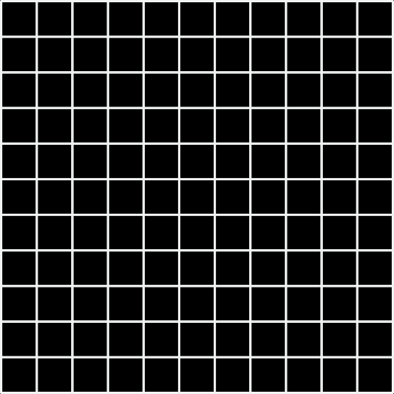

SC2001 SCSA PROJECT 2
DIJKSTRAS ALGORITHM
Group 3:
Ho Jian Feng
Isaac Chun
J’sen Ong
Notes:
Good afternoon everyone, I am XX, these are my group members XX and XX

Slide 2
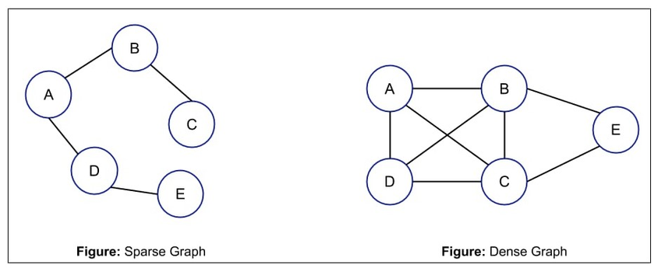
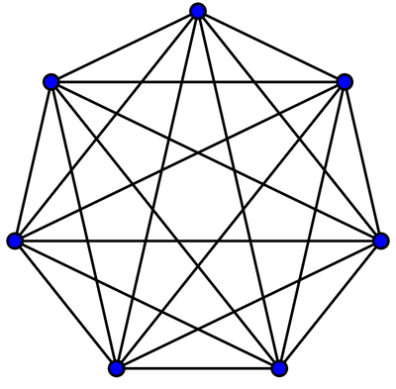
SPARSE & DENSE GRAPH DEFINITION
SPARSE GRAPH:
Number of edges is much smaller compared to the maximum possible number of edges.
Relatively few connections between the vertices.
Density of a sparse graph is low
DENSE GRAPH:
Number of edges is close to the maximum possible number of edges.
Many connections between the vertices.
Density of a dense graph is high
COMPLETE GRAPH:
Every pair of distinct vertices is connected by an edge
FIGURE: COMPLETE GRAPH
Notes:
To begin, sparse and dense graphs are terms used to describe the density of edges in a graph, where the density of a graph refers to the proportion of possible edges that are actually present in the graph.
A sparse graph is a graph in which the number of edges is much smaller compared to the maximum possible number of edges, and has a low density.
A dense graph is a graph in which the number of edges is close to the maximum possible number of edges, and has a high density.
Lastly, a complete graph is a type of simple undirected graph in which every pair of distinct vertices is connected by a unique edge.

Slide 3
1. ANALYZING TIME COMPLEXITY
Notes:
Let us now analyze the time complexity of Dijkstra's algorithm.

Slide 4
ADJACENCY MATRIX + ARRAY
LET GRAPH G = (V,E), AND LET G BE A COMPLETE GRAPH
|E| = [V(V-1)]/2
Removing/finding THE LOWEST WEIGHT NODE REQUIRES A LINEAR SEARCH THROUGH THE ARRAY O(|V|)
As each vertex is deleted from Q per loop, the time taken is O(|V|)
Therefore, the entire algorithm runs in O(|V|² + |E|) ~ O(|V|²)
 | Time Complexity
Extract lowest weight node from array (Priority Queue) | Number of vertices * (Linear Search + Relaxation) = O(|V|) * [O(|V|) + O(|V|)] = O(|V|²)
Updating Priority Queue | Number of edges * Update Array = O(|E|) * O(1) = O(|E|)
Total time | Extraction and updating = O(|V|²+ |E|) = O(|V|²)
Notes:
We start off by analyzing the time complexity of an implementation using an adjacency matrix and array. Let G be a complete graph with [V(V-1))/2] number of edges.
1. Removing and finding the lowest weight node requires a linear search through the array which takes O(V) time, and as each vertex is deleted from the priority queue only once per loop, the time taken per loop is O(V). Hence, the total time taken to extract and relax neighboring nodes would be O(|V|²).
2. Also, the number of times an edge could be updated would be in total |E|. Hence, the priority queue would be updated at most |E| times. The final complexity would then be O(V^2 + E), which is just O(V^2) as V^2 > E.

Slide 5
ADJACENCY LIST + MIN-HEAP
LET GRAPH G = (V,E), AND LET G BE A COMPLETE GRAPH
|E| = [V(V-1)]/2
EXTRACTING ROOT NODE TAKES LOG|V| AS WE HAVE TO FIX THE HEAP, AND THIS IS DONE FOR |V| TIMES.
In the worst case, updating costs only happens |E| times, which implies the total is O(|E|log|V|).
If G is weakly connected and |E| = |V| - 1, then the time running time is |E|log|V| as |V| is in O(|E|).
 | Time Complexity
FixHeap | O(log|V|)
Extract vertex from heap | Number of vertices * (FixHeap + Cost of extracting root node) = O(|V|) * [O(log|V|) + 0(1)] = O(|V| * log|V|)
Priority Queue Update Cost | Number of edges * (FixHeap) = O(|E|) * O(log|V|) = O(|E| * log|V|)
Total time | O(log|V|) + |V|log|V| + |E|log|V|) = O([|V| + |E|] *log|V|)
Notes:
Moving on, using the same example of a complete graph. We analyze the time complexity of an adjacency list and min heap implementation.
1. Fixing the heap takes log|V| time. Since we know that once V is taken out of the priority queue, it can not be added back in. Hence, extracting the root node is done exactly V times, which results in a total time complexity of O(V * logV) for all vertex removals from the heap.
2. Also, updating the priority of each edge also happens at most |E| times, where |E| is the total unique edges in the graph. Hence, for all priority queue updates, we get a total time complexity of O(|E| * log|V|).
3. Adding these running times together, we have O(|E|*log|V|) for all priority value updates and O(|V|* log|V|) for removing all vertices. Note there are also some other O(|E|) and O(|V|) additive terms such as initialization, but they are dominated by these two terms). This means the running time for Dijkstra's algorithm using a binary min-heap as a priority queue is O((|E|+|V|)log|V|).
4. Also, for a weakly connected sparse graph where |E| = |V| - 1, the running time would just be O(|E|logV) as |V| is in O(|E|).

Slide 6
2. ALGORITHM IMPLEMENTATION
Notes:
Now let's move on to the algorithm implementation in C++.

Slide 7
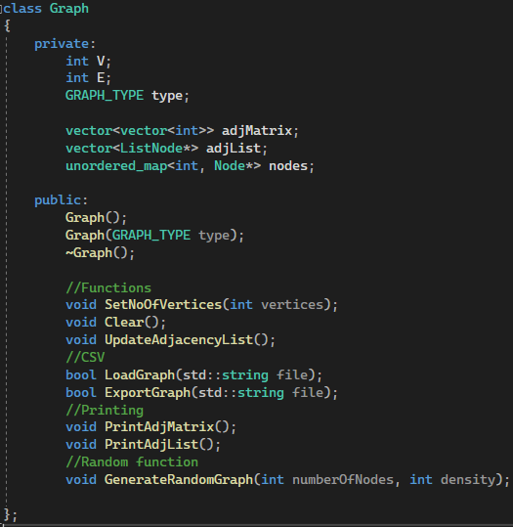
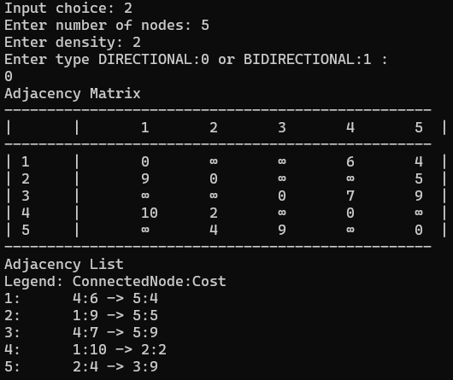
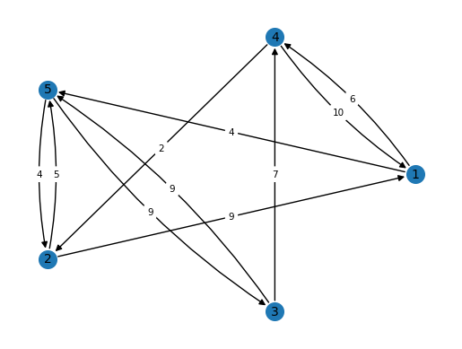

GRAPH
Graph Class
Random Generation and Export
(n =5, density =2)
Graph Visualization using NetworkX
For our random generation, the algorithm attempts to force each node to have “density” links to other nodes and connect them all, where we can control the amount of “neighbours” a node can have.
Notes:
We have implemented a graph class with the ability to hold our adjMatrix, adjList. More importantly, we have added the capability to generate a random directional or bidirectional graph given an input density and export it out into Python to visualize our graph.
For the random generation, the algorithm attempts to force each node to have exactly "density" links and connect them all together, where we can control the amount of "neighbors" a node can have. A complete graph where n and density are the same value can also be generated.

Slide 8
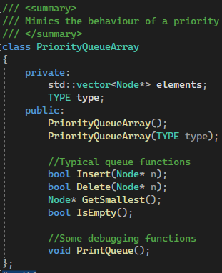
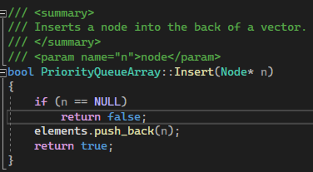
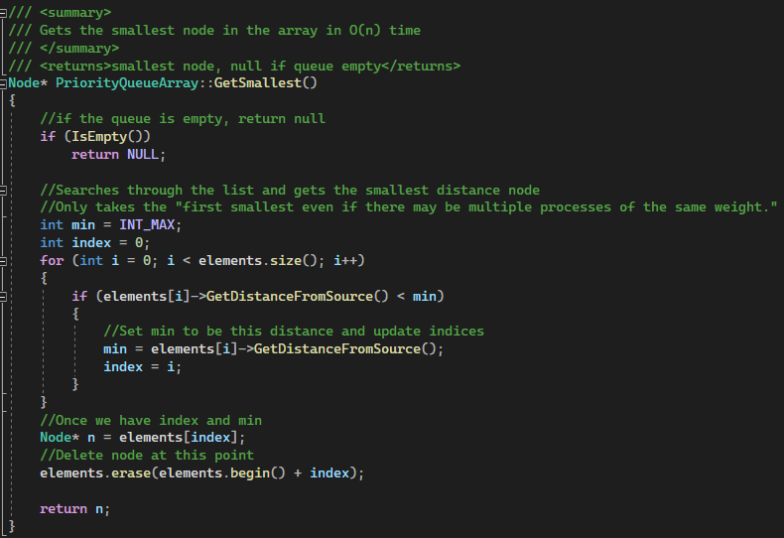
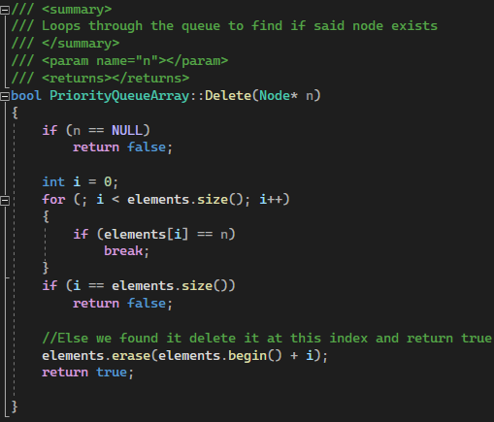
ARRAY IMPLEMENTATION
Class
Get node with smallest distance
Notes:
For our priority queue using array implementation, deletion, and getting the shortest distance node does a linear search in O(V) time. These operations are the slowest part of an array implementation as insertion and update is done in O(1) time.

Slide 9
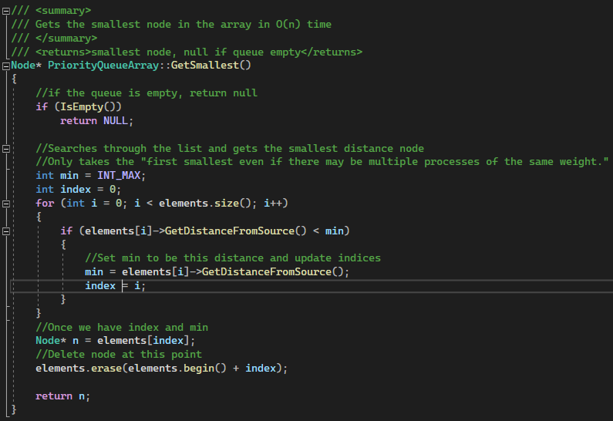
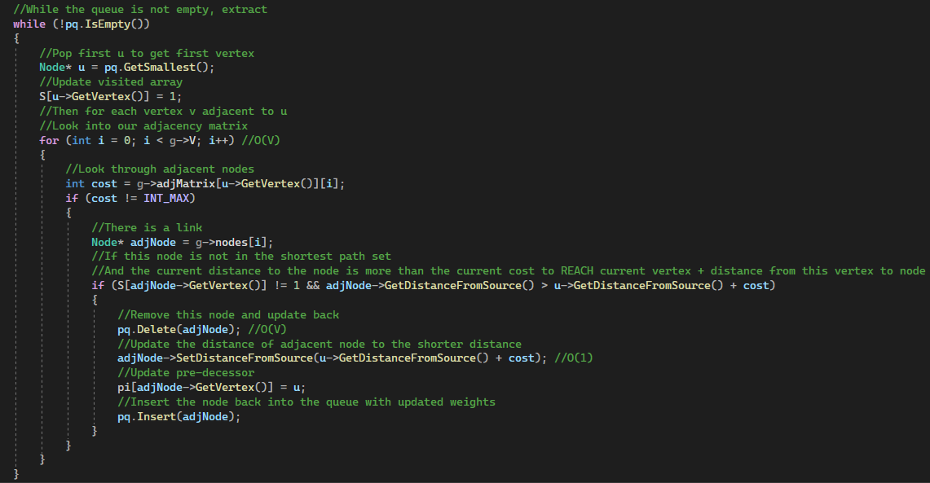
ADJACENCY MATRIX + ARRAY
Array Implementation
Dijkstra’s using array and adj matrix
Notes:
Combining the array implementation and adjacency matrix implementation, we get the following result where we can see exactly why the complexity was 0(V^2) as we have to scan every single element of the adj matrix regardless of density.

Slide 10
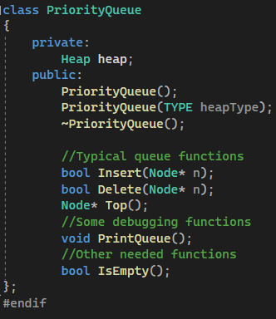
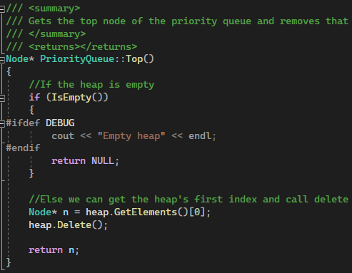
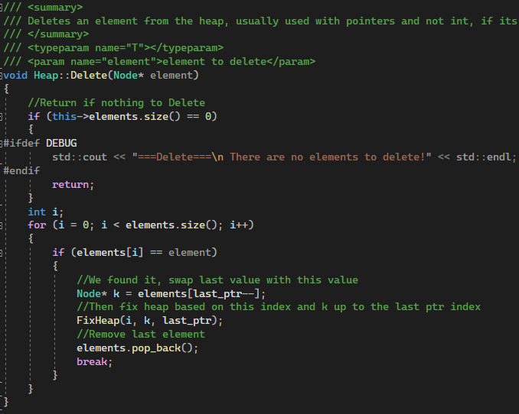
MIN HEAP IMPLEMENTATION
Notes:
To make things better, we implemented a min heap to fix the problems of the previous implementation. PriorityQueue is a wrapper class to hide the complexity of our heap class.

Slide 11
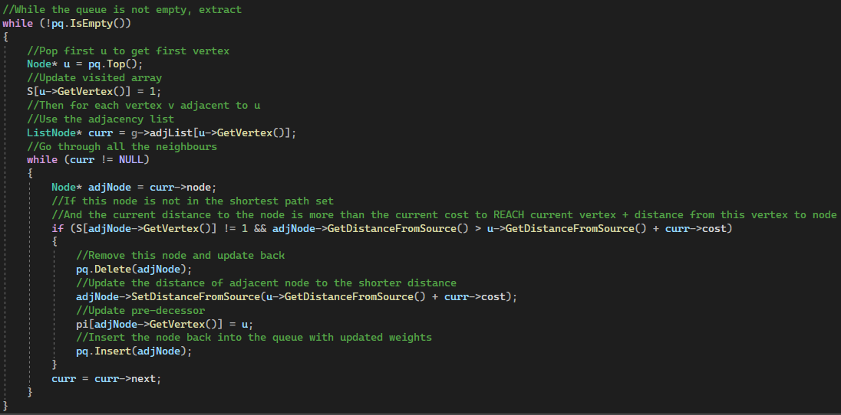
ADJACENCY LIST + MIN-HEAP
Heap Top
Dijkstra’s using adj list
Notes:
Now combining the min heap implementation with an adj list, the time taken to scan for neighbors is reduced from |V| to |E|, assuming E < V. Also, the time taken to get the shortest distance node is now log|V|, which is faster than a linear search through an array. Hence, we would expect to see that this approach would outperform an adj matrix and array implementation in GENERAL.

Slide 12
3. ARRAY VS MIN HEAP
Notes:
These are the results we obtained from both implementations

Slide 13
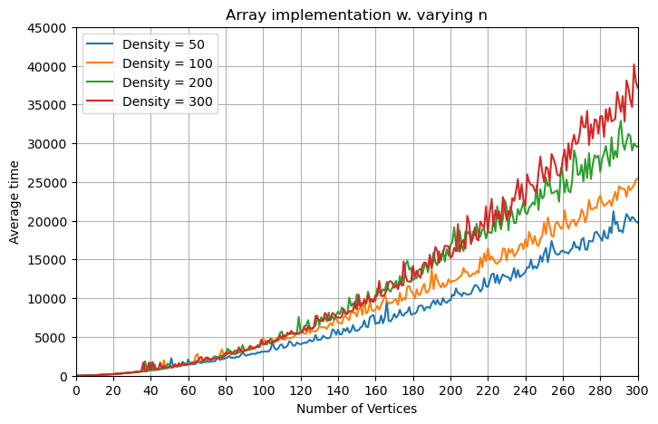
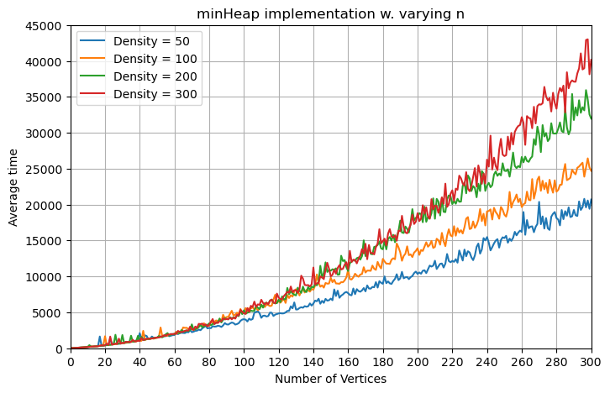
ARRAY & MINHEAP, VARYING N
Notes:
By plotting the performance of both implementations at different fixed graph densities and varying numbers of vertices on the x-axis, we can see that there is a positive correlation between the number of vertices and the density of the graph on the average time taken for both implementations of Dijkstra's algorithm.
The graphs here show clearly that both algorithms take a longer time as the number of vertices increases, at different fixed densities. However, we can note that both of them perform similarly at high densities, which will be examined in detail in the next few slides.

Slide 14
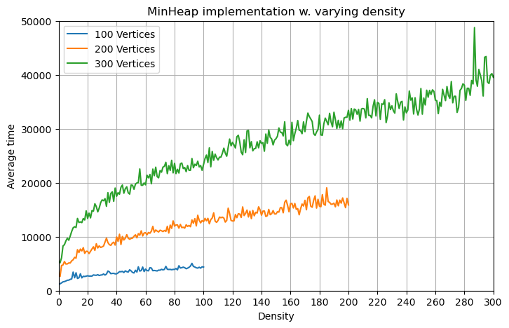
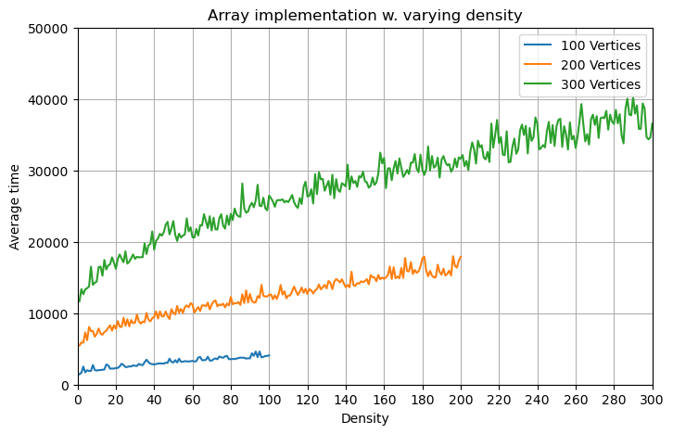
ARRAY & MINHEAP, VARYING DENSITY
Notes:
Fixing the number of vertices and increasing the density gradually, we observe that both algorithms take a longer time the denser the graph is.
However, we note that at low densities, the min heap implementation started at a lower point than the array implementation. Also, as the density increases, we can see that the time taken for minHeap slowly approaches the time for array, eventually ending around a similar point as the graph becomes denser. Hence we might expect that the array implementation performs better at higher densities.

Slide 15
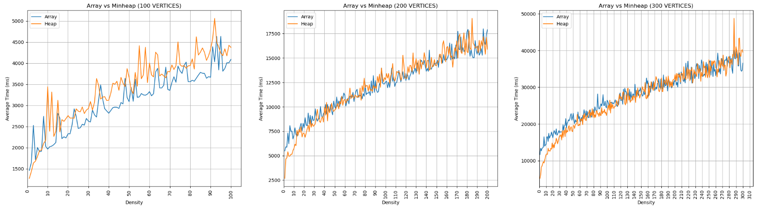
ARRAY VS MINHEAP, VARYING DENSITY
Notes:
By plotting both implementations on the same graph at different vertices, we see that minHeap does indeed take less time for low densities. However, as density increases, we observe that the performance becomes very similar to that of an array. Let us examine more about what happens at lower densities.

Slide 16
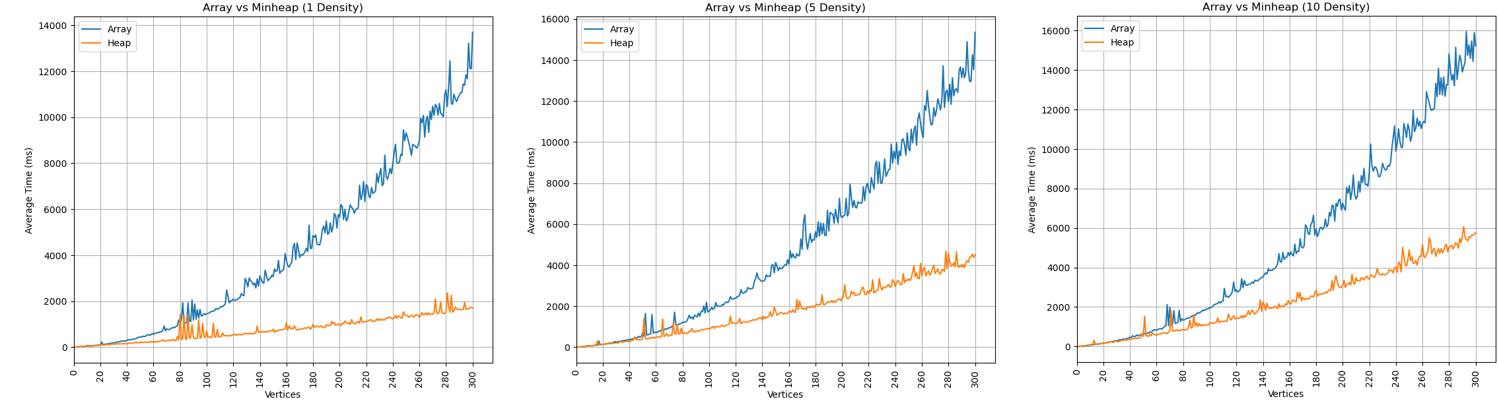
SPARSE VS DENSE GRAPHS
Notes:
At lower densities, we can see that the min heap performs much better on sparse graphs. As density increases, we can confirm that the rate of change of min heap approaches that of the array implementation which supports our initial observation.

Slide 17
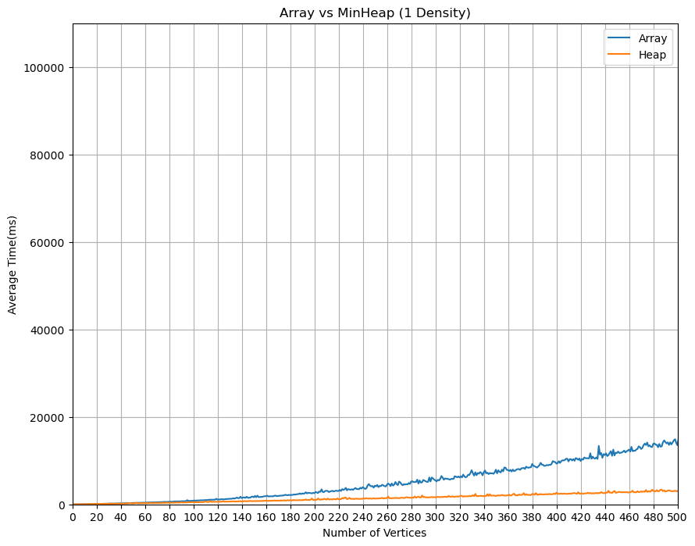
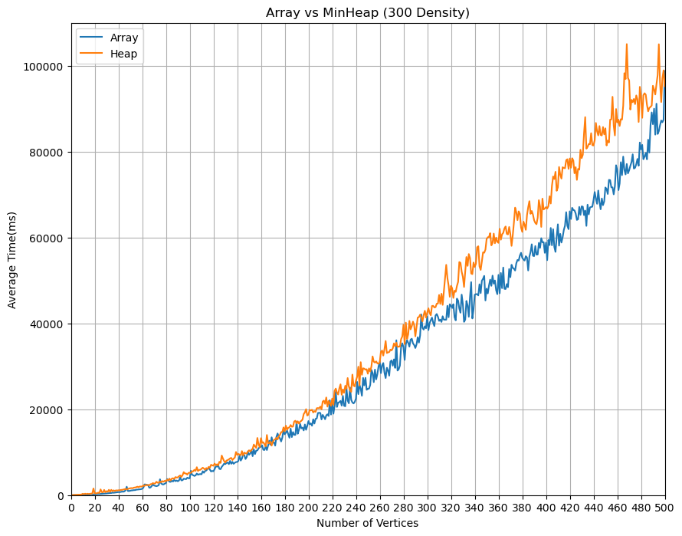
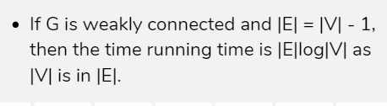
SPARSE VS DENSE GRAPHS
Density = 1
Density = 300
Array-based : O(|V|²)
MinHeap : O([|V| + |E|] * log|V|) -> O(|E| * log|V|)
Notes:
To confirm our initial theory, we plot 2 drastically different density value graphs side by side. In the case of density=1, each vertex has at most 1 outgoing edge to be relaxed.
At higher densities, we observe that minHeap performs worse than the array implementation, even if its initial time complexity was better. This is because as |E| tends to that of a complete graph, the min heap algorithm performs at the same class of a V^2 graph.

Slide 18
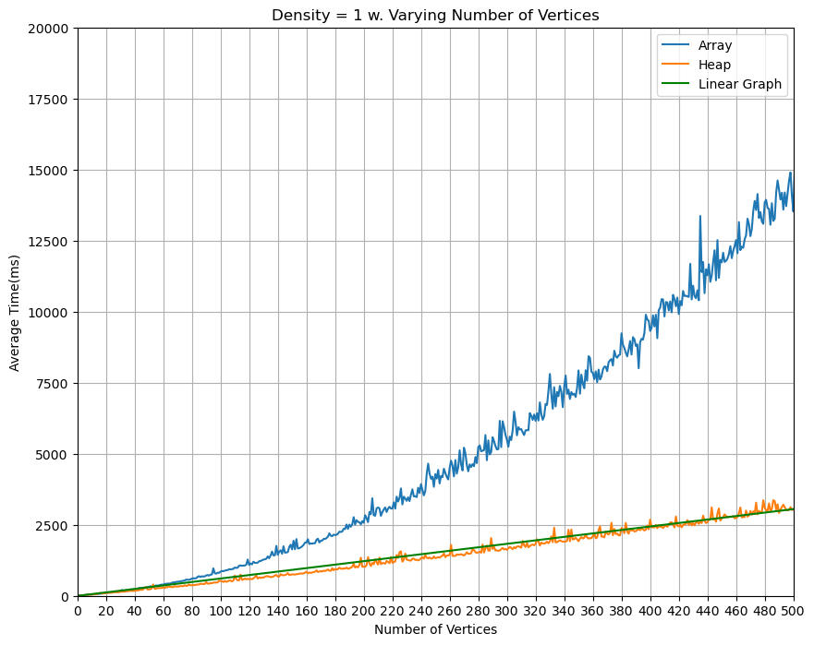
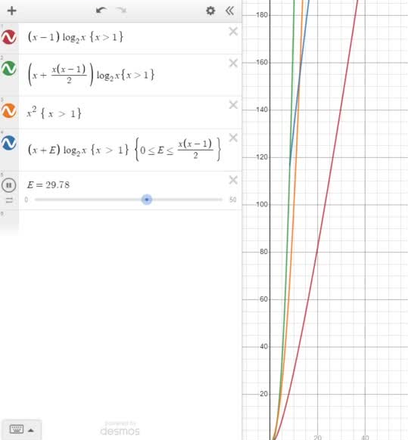
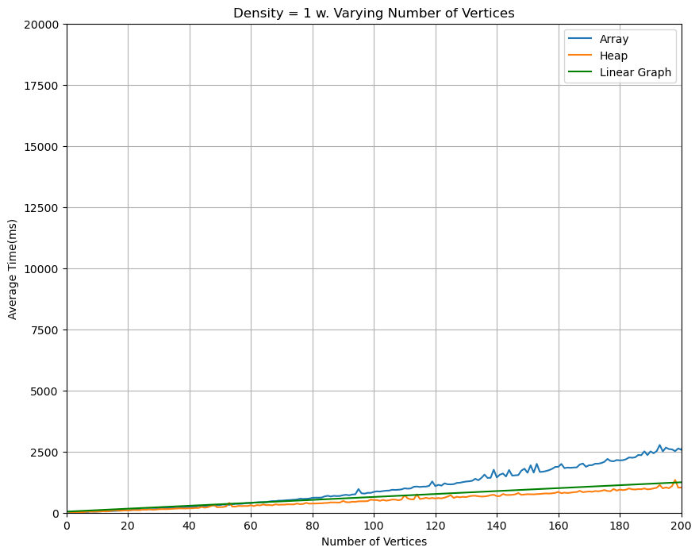
SPARSE VS DENSE GRAPHS
Density = 1
Complete |E| = V(V-1)/2 <- Leading term of V²
Array-based : O(|V|²)
MinHeap : O([|V| + |E|] * log|V|) -> O(|E| * log|V|)
Legends:
Sparse Graph
Dense complete Graph
Upper-lower bounds Graph
Figure 1. Empirical Result
Figure 2. Theoretical Result
Notes:
Plotting the theoretical graphs out, we see that our graph exhibits a similar trend as the red graph on the right, where it gradually tends toward a linear rate of change.
On the other hand, given a complete graph represented in green on the right, the time complexity has a leading term of v^2 since maximum possible edges = v(v-1)/2 and v^2 overpowers the logarithmic complexity, making the graph's rate exhibit a similar behavior of the x^2 in orange.
The red graph is now the lower bound and the green graph is now the maximum bound. Hence, the blue graph shows the rate of change as edges tend to maximum value.

Slide 19
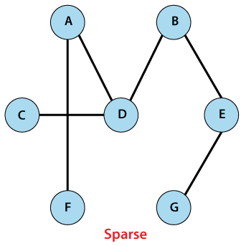
CONCLUSION
If G is dense -> Complete graph
Adjacency Matrix with array as Priority Queue
if G is sparse -> Weakly connected graph
Adjacency List with Min Heap as Priority Queue
FIGURE: COMPLETE GRAPH
Notes:
In conclusion, if the graph is dense and resembles a complete graph, using an adjacency matrix with an array as a priority queue would be more suitable. If G is sparse and is weakly connected, an adjacency list with minHeap as a priority queue will be more suitable.
In theory, accessing matrixes at contiguous locations might be faster than traversing a linked list, depending on where the data structure is in memory. Also, we cannot disregard recursion overheads in fixing our heap as that contributes to the total time taken as the number of vertices and edges increases.
However, all these depend on the programming language used, the implementation of the priority queues, and whether caching was involved. Discrepancies in implementations can cause timing results to differ. Thank you.

Slide 20
THANK YOU

